Slide 1
Lecture 5.0 Shortest Paths
Department of Computer Science
Hofstra University

Slide 2
Lecture Goals
IMPORTANT
In this lecture we study shortest-paths problems. We begin by analyzing some basic properties of shortest paths and a generic algorithm for the problem.
We introduce and analyze Dijkstra's algorithm for shortest-paths problems with nonnegative weights.
We conclude with the Bellman–Ford algorithm for edge-weighted digraphs with no negative cycles.

Slide 3
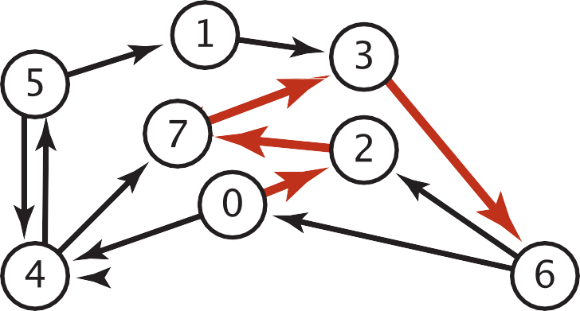
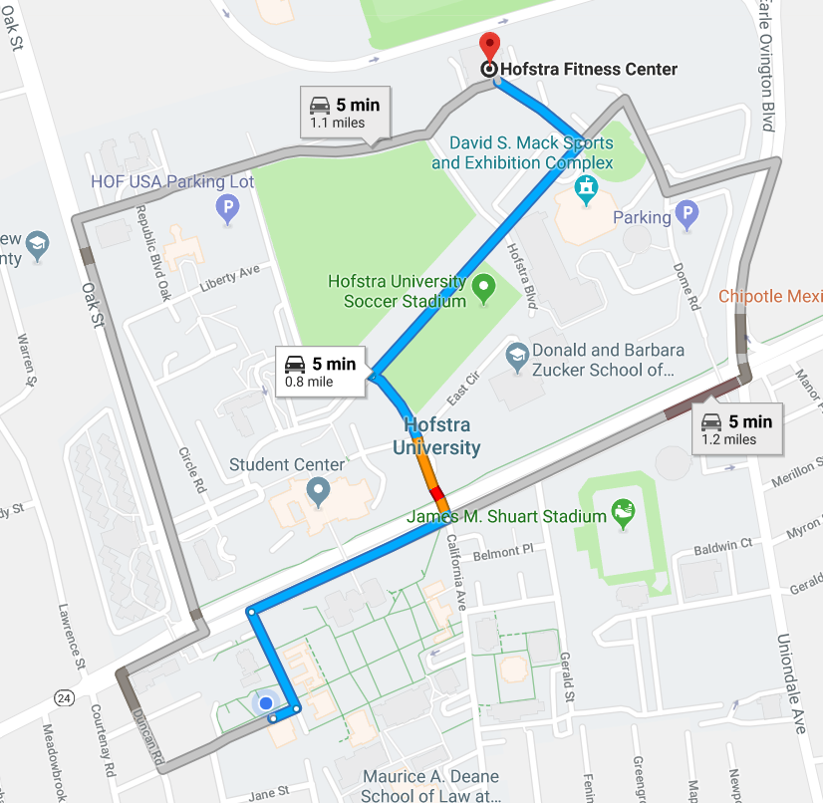

Shortest Paths in an Edge-weighted Digraph
Given an edge-weighted digraph, find the shortest path from s to t.
edge-weighted digraph
shortest path from 0 to 6
0->2 0.26
4->5 | 0.35
5->4 | 0.35
4->7 | 0.37
5->7 | 0.28
7->5 | 0.28
5->1 | 0.32
0->4 | 0.38
0->2 | 0.26
7->3 | 0.39
1->3 | 0.29
2->7 | 0.34
6->2 | 0.40
3->6 | 0.52
6->0 | 0.58
6->4 | 0.93
2->7 | 0.34
7->3 | 0.39
3->6 | 0.52
Variants
Can we use BFS?
Which vertices?
Single source: from one vertex s to every other vertex.
Source-sink: from one vertex s to another t.
All pairs: between all pairs of vertices.
Nonnegative weights?
Cycles?
Negative cycles.
Simplifying assumption: Each vertex is reachable from s.

Slide 4

Edge Relaxation
Relax edge e = v→w. (basic of building SPT)
distTo[v] is length of shortest known path from s to v.
distTo[w] is length of shortest known path from s to w.
prevNode[w] is the previous node on shortest known path from s to w.
If e = v→w gives shorter path to w through v, update distTo[w] and prevNode[w].
distTo[w] = min(distTo[w], distTo[v] + e.weight()); prevNode[w]=v
private void relax(DirectedEdge e)
{
int v = e.from(), w = e.to();
if (distTo[w] > distTo[v] + e.weight())
{
distTo[w] = distTo[v] + e.weight();
prevNode[w] = v;
}
}
After relaxing edge v→w, the shortest path from s to w is updated to go through node v, with cost of 4.4
prevNode[w] = v
3.1
v
1.3
s
w
7.2
OLD distTo[w] = 7.2 > distTo[v] + e.weight()
= 3.1+1.3 = 4.4
NEW distTo[w] ← distTo[v] + e.weight() = 4.4, prevNode[w] = v
u
Previous shortest path from s to w goes through node u, with cost of 7.2

Slide 5
Generic Shortest-paths Algorithm
Generic algorithm (to compute SPT from s)
For each vertex v: distTo[v] = ∞.
For each vertex v: prevNode[v] = null.
distTo[s] = 0.
Repeat until done:
- Relax any edge.
Proposition. Generic algorithm computes SPT (if it exists) from s.
Pf.
Throughout algorithm, distTo[v] is the length of a simple path from s to v (and prevNode[v] is its previous node on the path).
Each successful relaxation decreases distTo[v] for some v.
The entry distTo[v] can decrease at most a finite number of times.
Efficient implementations. How to choose which edge to relax?
Ex 1. Dijkstra’s algorithm. (no negative weights).
Ex 2. Bellman–Ford algorithm. (negative weights, no negative cycles).
Notes:
Ex 2. Topological sort algorithm. (no directed cycles).

Slide 6
Dijkstra's Algorithm
Initialization:
Set the distance to the source node as 0 and to all other nodes as infinity.
Mark all nodes as unvisited and store them in a priority queue.
Main Loop:
Visit the unvisited node v with the shortest known distance from the queue.
For each unvisited neighbor node w of node v, calculate its tentative distance through the current node. If this distance is smaller than the previously recorded distance, update it with edge relaxation for edge v-w.
Mark the current node as visited once all its neighbors are processed.
Termination:
The algorithm continues until all reachable nodes are visited, or until the shortest path to a specific destination is found.
(Note: Dijkstra’s algorithm works for both undirected and directed graphs. The only difference is the function for getting the neighbors of node v, which follows the edge arrow direction for directed graphs.)

Slide 7
Dijkstra’s Algorithm: Correctness Proof
Proposition. Dijkstra's algorithm computes a SPT in any edge-weighted digraph with nonnegative weights.
Pf.
Each edge e = v→w is relaxed exactly once (when v is relaxed),
leaving distTo[w] ≤ distTo[v] + e.weight().
Inequality holds until algorithm terminates because:
distTo[w] cannot increase
distTo[v] will not change
Thus, upon termination, shortest-paths optimality conditions hold.
distTo[ ] values are monotone decreasing
we choose lowest distTo[ ] value at each step (and edge weights are nonnegative)

Slide 8
Toy Example: find shortest path starting from source node S for undirected graph
A
2
S
1
4
B
N1 | SD | PN
S | 0
A | $$∞$$
B | $$∞$$
N1 | SD | PN
S | 0
A | 2 | S
B | 4 | S
N1 | SD | PN
S | 0
A | 2 | S
B | 3 | A
N1 | SD | PN
S | 0
A | 2 | S
B | 3 | A
Visit S
Visit A
Visit B
A
2
S
3
4
B
N1 | SD | PN
S | 0
A | $$∞$$
B | $$∞$$
N1 | SD | PN
S | 0
A | 2 | S
B | 4 | S
N1 | SD | PN
S | 0
A | 2 | S
B | 4 | S
N1 | SD | PN
S | 0
A | 2 | S
B | 4 | S
Visit S
Visit A
Visit B

Slide 9
Toy Example: find shortest path starting from source node S for directed graph
A
2
S
1
4
B
N1 | SD | PN
S | 0
A | $$∞$$
B | $$∞$$
N1 | SD | PN
S | 0
A
B
N1 | SD | PN
S | 0
A
B
N1 | SD | PN
S | 0
A
B
Visit S
Visit
Visit B
A
2
S
1
4
B
N1 | SD | PN
S | 0
A | $$∞$$
B | $$∞$$
N1 | SD | PN
S | 0
A
B
N1 | SD | PN
S | 0
A
B
N1 | SD | PN
S | 0
A
B
Visit S
Visit A
Visit B

Slide 10
Video Tutorials
Dijkstras Shortest Path Algorithm Explained | With Example | Graph Theory
https://www.youtube.com/watch?v=bZkzH5x0SKU
The following lecture slides are based on this video
Dijkstra's algorithm in 3 minutes
https://www.youtube.com/watch?v=_lHSawdgXpI
Bellman-Ford in 4 minutes — Theory
https://www.youtube.com/watch?v=9PHkk0UavIM
Bellman-Ford in 5 minutes — Step by step example
https://www.youtube.com/watch?v=obWXjtg0L64

Slide 11
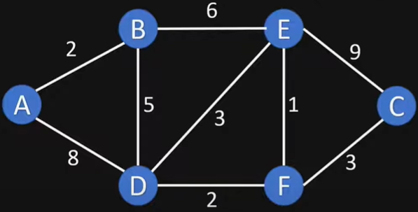
Example Graph

Slide 12
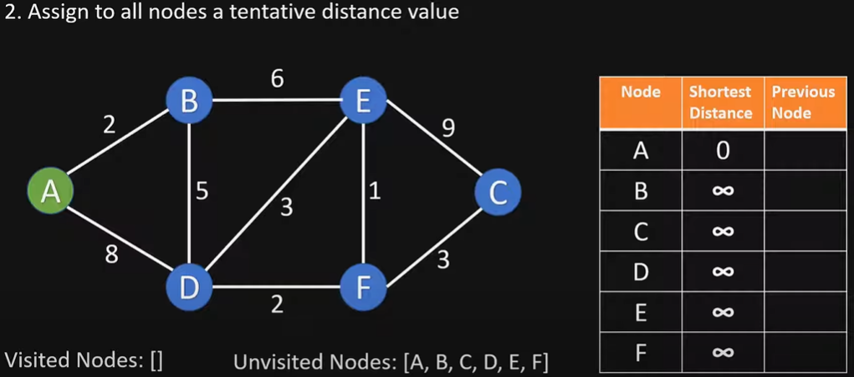
Initialize

Slide 13
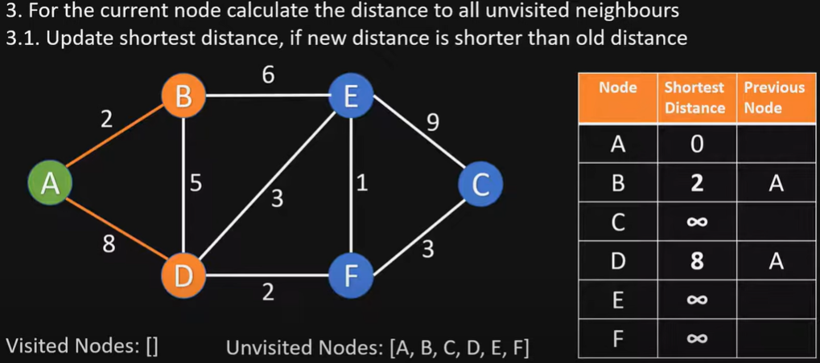
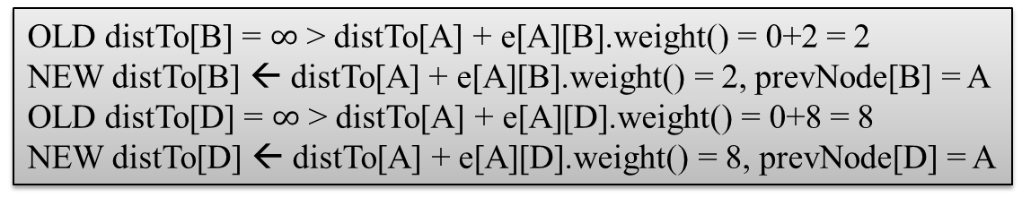
Visit Node A
OLD distTo[B] = $∞$ > distTo[A] + e[A][B].weight() = 0+2 = 2
NEW distTo[B] ← distTo[A] + e[A][B].weight() = 2, prevNode[B] = A
OLD distTo[D] = $∞$ > distTo[A] + e[A][D].weight() = 0+8 = 8
NEW distTo[D] ← distTo[A] + e[A][D].weight() = 8, prevNode[D] = A

Slide 14
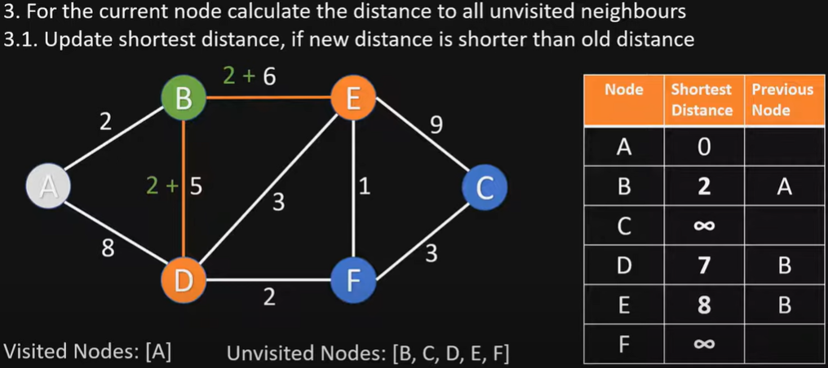
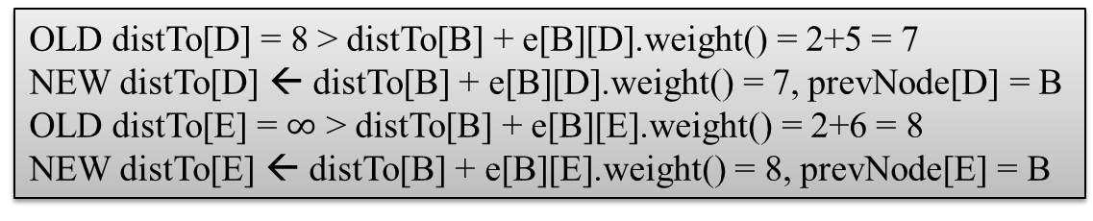
Visit Node B
OLD distTo[D] = 8 > distTo[B] + e[B][D].weight() = 2+5 = 7
NEW distTo[D] ← distTo[B] + e[B][D].weight() = 7, prevNode[D] = B
OLD distTo[E] = $∞$ > distTo[B] + e[B][E].weight() = 2+6 = 8
NEW distTo[E] ← distTo[B] + e[B][E].weight() = 8, prevNode[E] = B

Slide 15
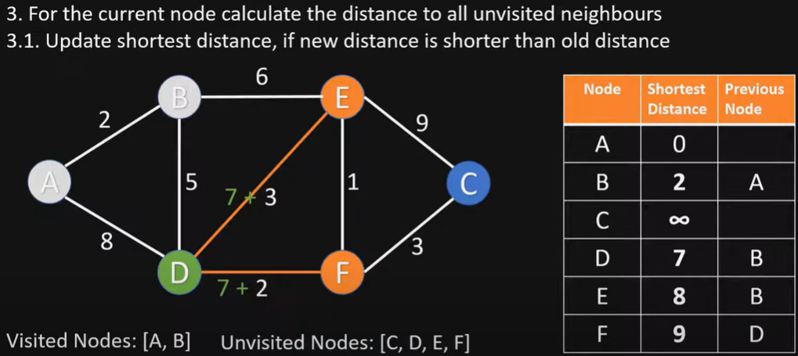
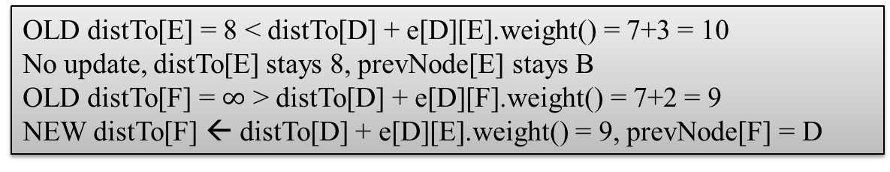
Visit Node D
OLD distTo[E] = 8 < distTo[D] + e[D][E].weight() = 7+3 = 10
No update, distTo[E] stays 8, prevNode[E] stays B
OLD distTo[F] = $∞$ > distTo[D] + e[D][F].weight() = 7+2 = 9
NEW distTo[F] ← distTo[D] + e[D][E].weight() = 9, prevNode[F] = D

Slide 16
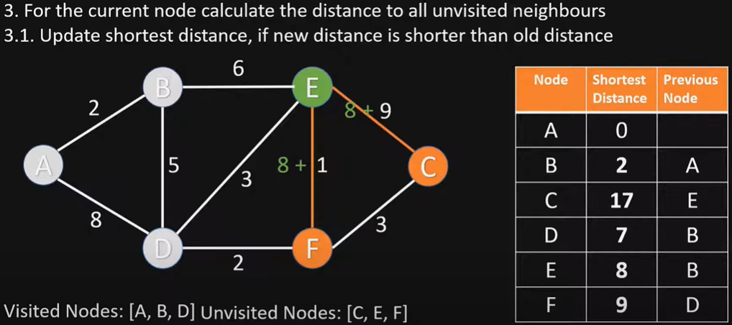
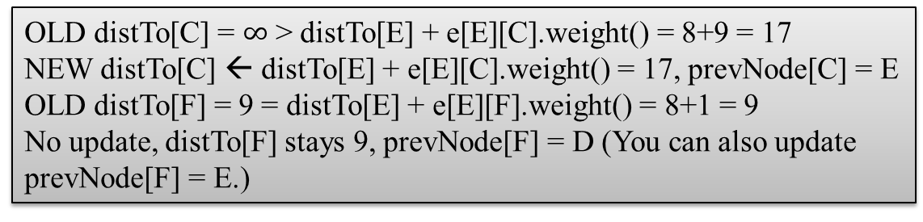
Visit Node E
OLD distTo[C] = $∞$ > distTo[E] + e[E][C].weight() = 8+9 = 17
NEW distTo[C] ← distTo[E] + e[E][C].weight() = 17, prevNode[C] = E
OLD distTo[F] = 9 = distTo[E] + e[E][F].weight() = 8+1 = 9
No update, distTo[F] stays 9, prevNode[F] = D (You can also update prevNode[F] = E.)

Slide 17
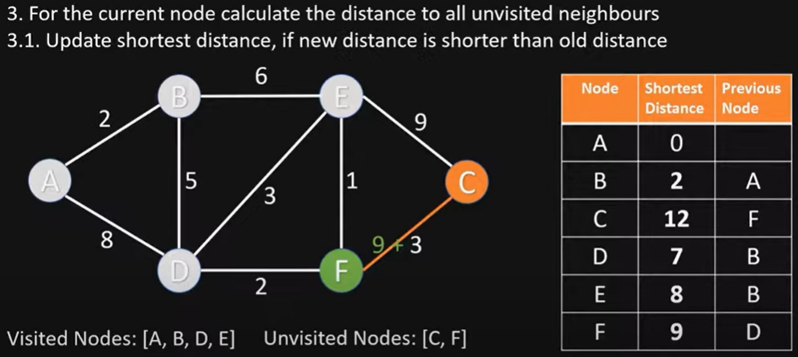
Visit Node F
OLD distTo[C] = 17 > distTo[F] + e[F][C].weight() = 9+3 = 12
NEW distTo[C] ← distTo[F] + e[F][C].weight() = 12, prevNode[C] = F

Slide 18
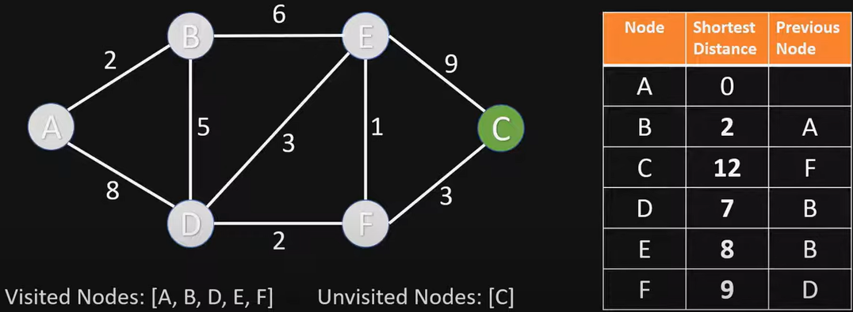
Visit Node C
Nothing changes, since C has no unvisited neighbor nodes

Slide 19
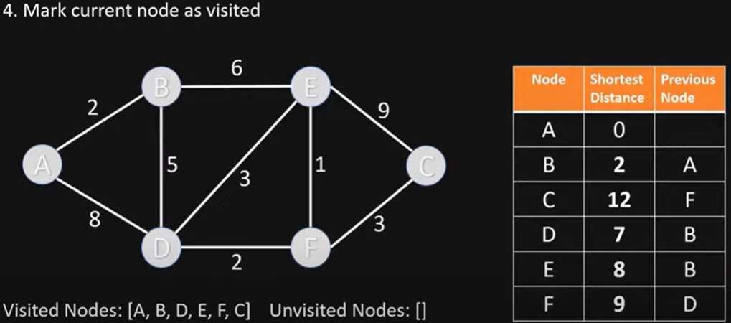
End of Algorithm
Table contains the shortest distance to each node N from the source node A, and its previous node in the shortest path

Slide 20
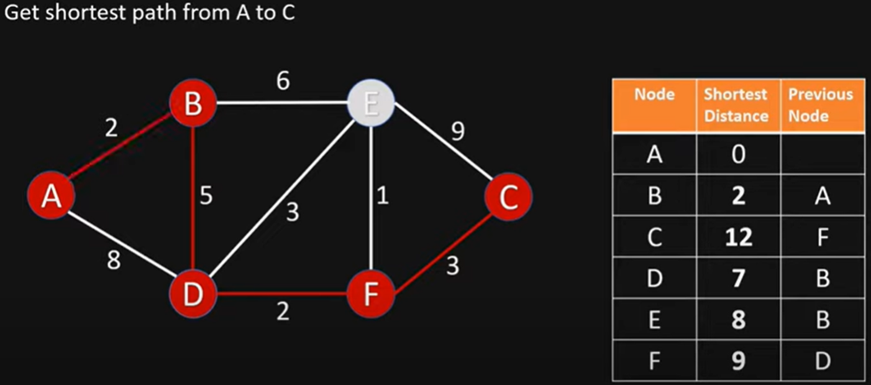
Getting the Shortest Path from A to C
C’s previous node is F; F’s previous node is D; D’s previous node is B; B’s previous node is A
Shortest Path from A to C is ABDFC

Slide 21
Dijkstra’s Algorithm Example 2
3
B
D
3
1
A
1
2
1
C
E
4
Notes:
David Kauchak
cs161
Summer 2009
Graphs: MSTs and Shortest Paths https://cs.pomona.edu/~dkauchak/classes/algorithms/

Slide 22
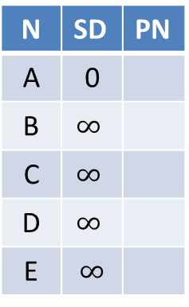
Initialize
∞
∞
3
N | SD | PN
A | 0
B | $$∞$$
C | $$∞$$
D | $$∞$$
E | $$∞$$
B
D
3
0
1
A
1
2
∞
1
C
E
∞
4

Slide 23
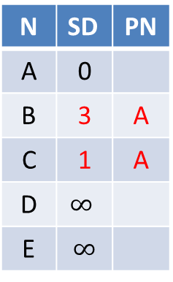
Visit Node A
3
∞
3
N | SD | PN
A | 0
B | 3 | A
C | 1 | A
D | $$∞$$
E | $$∞$$
B
D
3
0
1
A
1
2
1
1
C
E
∞
4

Slide 24
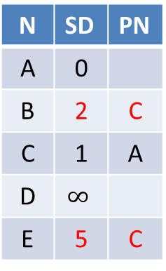
Visit Node C
2
∞
3
N | SD | PN
A | 0
B | 2 | C
C | 1 | A
D | $$∞$$
E | 5 | C
B
D
3
0
1
A
1
2
1
1
C
E
5
4

Slide 25
Visit Node B
2
5
3
N | SD | PN
A | 0
B | 2 | C
C | 1 | A
D | 5 | B
E | 3 | B
B
D
3
0
1
A
1
2
1
1
C
E
3
4

Slide 26
Visit Node E
2
5
3
B
D
N | SD | PN
A | 0
B | 2 | C
C | 1 | A
D | 5 | B
E | 3 | B
3
0
1
A
1
2
1
1
C
E
3
4
Nothing changes

Slide 27
Visit Node D
2
5
3
N | SD | PN
A | 0
B | 2 | C
C | 1 | A
D | 5 | B
E | 3 | B
B
D
3
0
1
A
1
2
1
1
C
E
3
4
Nothing changes

Slide 28
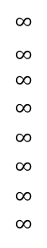
Dijkstra’s Algorithm Example 3
choose vertex 5
relax all edges adjacent from 5
choose vertex 2
relax all edges adjacent from 2
choose vertex 3
relax all edges adjacent from 3
choose vertex 6
relax all edges adjacent from 6
Consider vertices in increasing order of distance from s
(non-tree vertex with the lowest distTo[ ] value).
Add vertex to tree and relax all edges pointing from that vertex.
1
v distTo[]
15
3
$$∞$$
$∞$ $∞$
$$∞$$
$$∞$$
$$∞$$
$$∞$$
$$∞$$
0
5
17
20
9
14
29
8
15
17
13
26
14
25
0
1
2
3
4
5
6
7
5
4
12
0
3
8
7
2
7
9
9
5
6
1
5
11
v edgeTo[]
4
4
13
6
0
1
2
3
4
5
6
7
-
-
-
-
-
-
-
-
0
1
1
0
7
4
0
7
2
4
5
5
2
20
choose source vertex 0
relax all edges adjacent from 0
choose vertex 1
relax all edges adjacent from 1
choose vertex 7
relax all edges adjacent from 7
choose vertex 4
relax all edges adjacent from 4

Slide 29
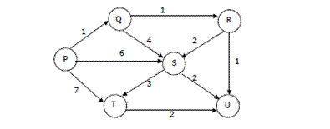
Dijkstra’s Algorithm Example 4
Suppose we run Dijkstra’s single source shortest-path algorithm on the following edge weighted directed graph with vertex P as the source. In what order do the nodes get included into the set of vertices for which the shortest path distances are finalized?
ANS: P, Q, R, U, S, T

Slide 30
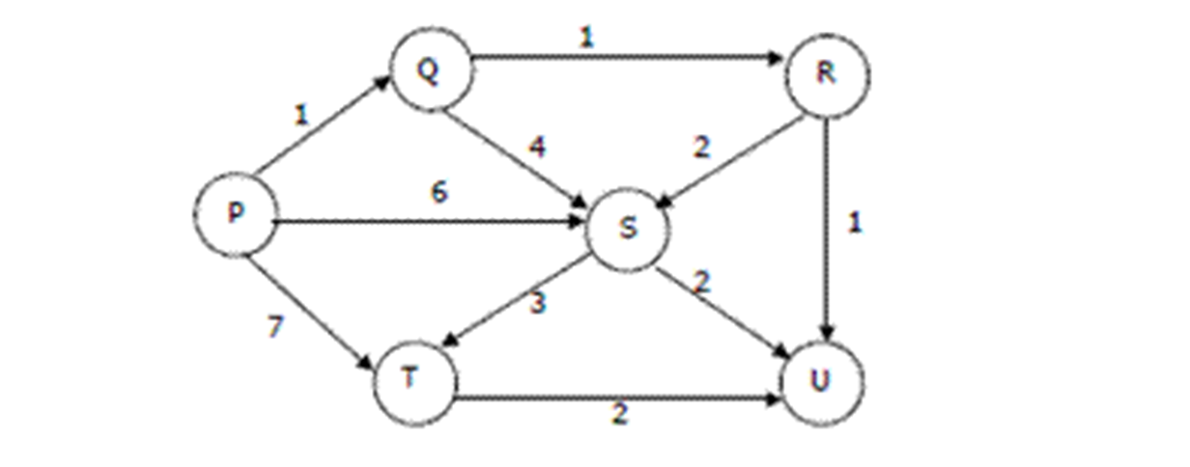
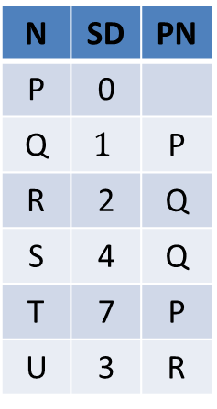
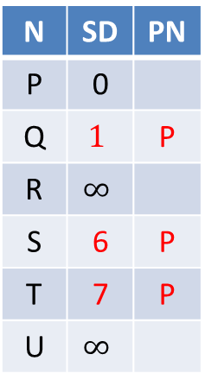

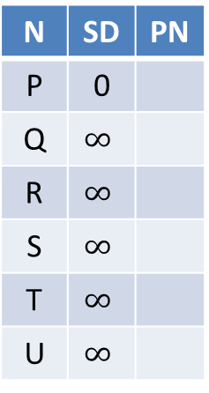
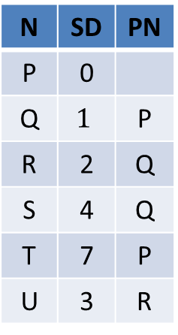
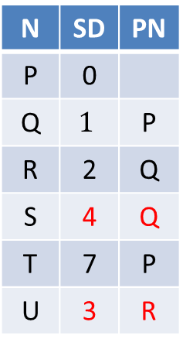
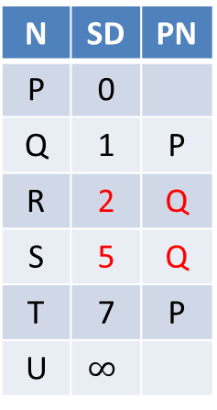
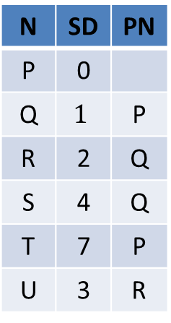
SD: Shortest Distance
PN: Previous Node
N | SD | PN
P | 0
Q | $$∞$$
R | $$∞$$
S | $$∞$$
T | $$∞$$
U | $$∞$$
N | SD | PN
P | 0
Q | $$1$$ | P
R | $$∞$$
S | 6 | P
T | 7 | P
U | $$∞$$
N | SD | PN
P | 0
Q | 1 | P
R | 2 | Q
S | 5 | Q
T | 7 | P
U | $$∞$$
N | SD | PN
P | 0
Q | $$1$$ | P
R | 2 | Q
S | 4 | Q
T | 7 | P
U | 3 | R
Visit P
Visit Q
Visit R
Visit U (nothing changes)
N | SD | PN
P | 0
Q | $$1$$ | P
R | 2 | Q
S | 4 | Q
T | 7 | P
U | 3 | R
N | SD | PN
P | 0
Q | $$1$$ | P
R | 2 | Q
S | 4 | Q
T | 7 | P
U | 3 | R
N | SD | PN
P | 0
Q | $$1$$ | P
R | 2 | Q
S | 4 | Q
T | 7 | P
U | 3 | R
N | SD | PN
P | 0
Q | $$1$$ | P
R | 2 | Q
S | 4 | Q
T | 7 | P
U | 3 | R
Visit S
Visit T
Finished
(nothing
changes)
(nothing
changes)

Slide 31
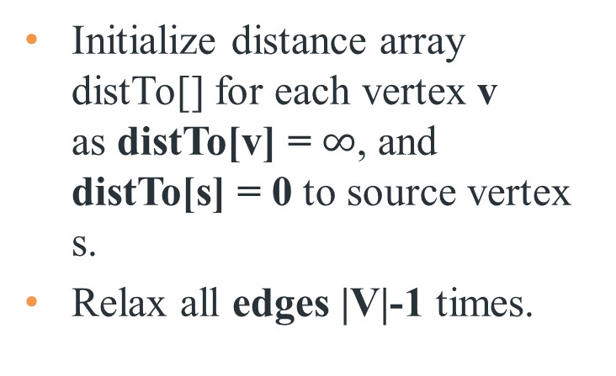
Bellman-Ford Algorithm
IMPORTANT
Initialize distance array distTo[] for each vertex v as distTo[v] = $∞$, and distTo[s] = 0 to source vertex s.
Relax all edges |V|-1 times.
Recall:
Generic algorithm (to compute SPT from s)
For each vertex v: distTo[v] = ∞.
For each vertex v: edgeTo[v] = null.
distTo[s] = 0.
Repeat until done:
- Relax any edge.
private void relax(DirectedEdge e)
{
int v = e.from(), w = e.to();
if (distTo[w] > distTo[v] + e.weight())
{
distTo[w] = distTo[v] + e.weight();
edgeTo[w] = e;
}
}
Bellman–Ford algorithm
For each vertex v: distTo[v] = ∞.
For each vertex v: edgeTo[v] = null.
distTo[s] = 0.
Repeat |V | -1 times:
- Relax each edge.
Notes:
Now, Relax all the edges one more time i.e. the Nth time and based on the below two cases we can detect the negative cycle:
Case 1 (Negative cycle exists): For any edge(u, v, weight), if dist[u] + weight < dist[v]
Case 2 (No Negative cycle) : case 1 fails for all the edges.
Initialize distance array dist[] for each vertex ‘v‘ as dist[v] = INFINITY.
Assume any vertex (let’s say ‘0’) as source and assign dist = 0.
Relax all the edges(u,v,weight) N-1 times as per the below condition:
dist[v] = minimum(dist[v], distance[u] + weight)
Now, Relax all the edges one more time i.e. the Nth time and based on the below two cases we can detect the negative cycle:
Case 1 (Negative cycle exists): For any edge(u, v, weight), if dist[u] + weight < dist[v]
Case 2 (No Negative cycle) : case 1 fails for all the edges.

Slide 32
Bellman-Ford Algorithm Proof of Correctness
Relaxing edges |V|-1 times in the Bellman-Ford Algorithm guarantees that the algorithm has explored all possible paths of length up to |V|-1, which is the maximum possible length of a shortest path in a graph with |V| vertices. This allows the algorithm to correctly calculate the shortest paths from the source vertex to all other vertices, given that there are no negative-weight cycles.

Slide 33
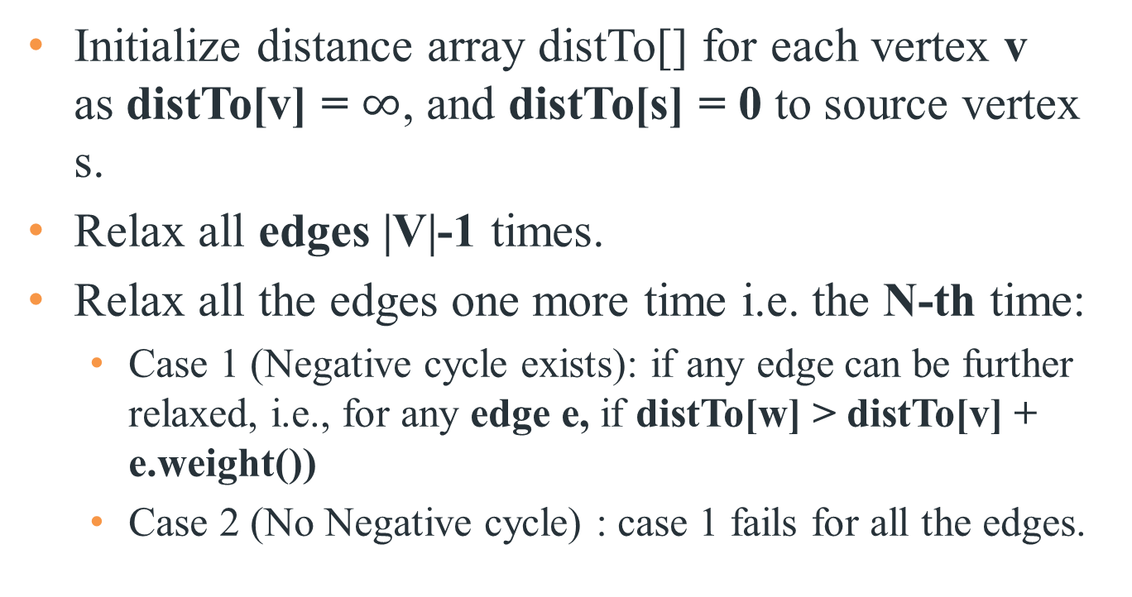
Bellman-Ford Algorithm with Negative Cycle Detection
Initialize distance array distTo[] for each vertex v as distTo[v] = $∞$, and distTo[s] = 0 to source vertex s.
Relax all edges |V|-1 times.
Relax all the edges one more time i.e. the N-th time:
Case 1 (Negative cycle exists): if any edge can be further relaxed, i.e., for any edge e, if distTo[w] > distTo[v] + e.weight())
Case 2 (No Negative cycle) : case 1 fails for all the edges.
Notes:
Initialize distance array dist[] for each vertex ‘v‘ as dist[v] = INFINITY.
Assume any vertex (let’s say ‘0’) as source and assign dist = 0.
Relax all the edges(u,v,weight) N-1 times as per the below condition:
dist[v] = minimum(dist[v], distance[u] + weight)
Now, Relax all the edges one more time i.e. the Nth time and based on the below two cases we can detect the negative cycle:
Case 1 (Negative cycle exists): For any edge(u, v, weight), if dist[u] + weight < dist[v]
Case 2 (No Negative cycle) : case 1 fails for all the edges.

Slide 34
Time Complexity of Bellman-Ford Algorithm
Time complexity for connected graph:
Best Case: O(|E|), when distance array after 1st and 2nd relaxation are same , we can simply stop further processing after one iteration
Average Case: O(|V|*|E|)
Worst Case: O(|V|*|E|)
If the graph is complete, the value of E becomes O(|V|²). So overall time complexity becomes O(|V|³)
Notes:
What is the time complexity of Bellman-Ford single-source shortest path algorithm on a complete graph of n vertices?
ANS: O(V3)
Time complexity of Bellman-Ford Algorithm Example 1 is O(VE) where V is number of vertices and E is number edges . If the graph is complete, the value of E becomes O(V2). So overall time complexity becomes O(V3)

Slide 35
Bellman-Ford Algorithm Example 1
0
∞
10
S
A
Iteration: 0
8
1
∞
∞
G
-4
B
2
1
1
-2
C
∞
F
∞
-1
3
E
D
-1
∞
∞

Slide 36
Bellman-Ford Algorithm Example 1
0
10
10
S
A
Iteration: 1
8
1
∞
8
G
-4
B
2
1
1
-2
C
∞
F
∞
-1
3
E
D
-1
∞
∞

Slide 37
Bellman-Ford Algorithm Example 1
0
10
10
S
A
Iteration: 2
8
1
∞
8
G
-4
B
2
1
1
-2
C
∞
F
9
-1
3
E
D
-1
12
∞

Slide 38
Bellman-Ford Algorithm Example 1
0
5
10
S
A
Iteration: 3
8
1
10
8
G
-4
B
A has the correct distance and path
2
1
1
-2
C
∞
F
9
-1
3
E
D
-1
8
∞

Slide 39
Bellman-Ford Algorithm Example 1
0
5
10
S
A
Iteration: 4
8
1
6
8
G
-4
B
2
1
1
-2
C
11
F
9
-1
3
E
D
-1
7
∞

Slide 40
Bellman-Ford Algorithm Example 1
0
5
10
S
A
Iteration: 5
8
1
5
8
G
-4
B
B has the correct distance and path
2
1
1
-2
C
7
F
9
-1
3
E
D
-1
7
14

Slide 41
Bellman-Ford Algorithm Example 1
0
5
10
S
A
Iteration: 6
8
1
5
8
G
-4
B
2
1
1
-2
C
6
F
9
-1
3
E
D
-1
7
10

Slide 42
Bellman-Ford Algorithm Example 1
0
5
10
S
A
Iteration: 7
8
1
5
8
G
-4
B
D (and all other nodes) have the correct distance and path
2
1
1
-2
C
6
F
9
-1
3
E
D
-1
7
9

Slide 43
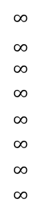
Bellman-Ford Algorithm Example 2
Repeat V − 1 times: relax all E edges.
v distTo[]
0
1
2
3
4
5
6
7
$$∞$$
$∞$ $∞$
$$∞$$
$$∞$$
$$∞$$
$$∞$$
$$∞$$
0
5
17
20
9
13
28
8
14
17
26
25
1
15
3
5
4
12
0
3
8
7
2
7
9
v edgeTo[]
9
5
6
1
0
1
2
3
4
5
6
7
-
-
-
-
-
-
-
-
0
1
1
0
4
2
0
5
2
5
2
5
11
4
4
13
20
6
pass 1
pass 2
pass 3
(no further changes)
pass 4-7 (no further changes)
0→1 0→4 0→7 1→2 1→3 1→7 2→3 2→6 3→6 4→5 4→6 4→7 5→2 5→6 7→2 7→5

Slide 44
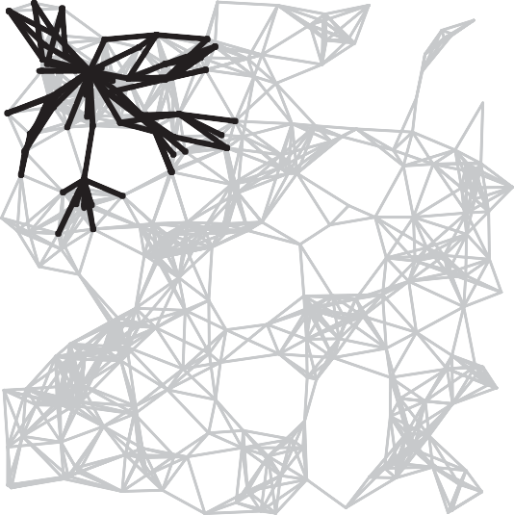
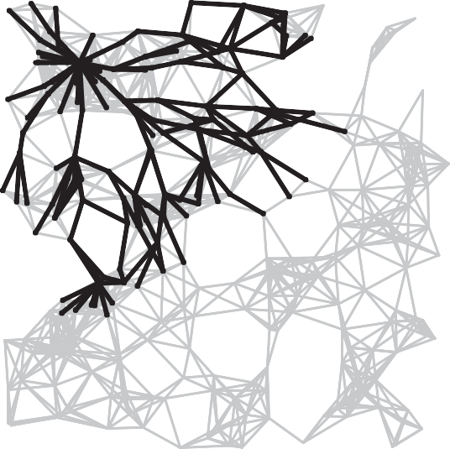
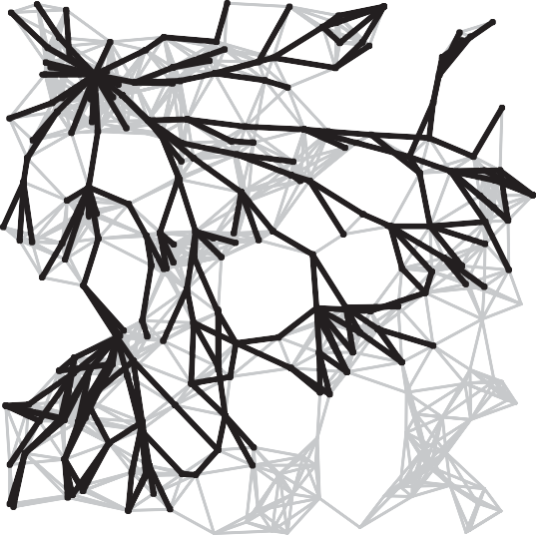
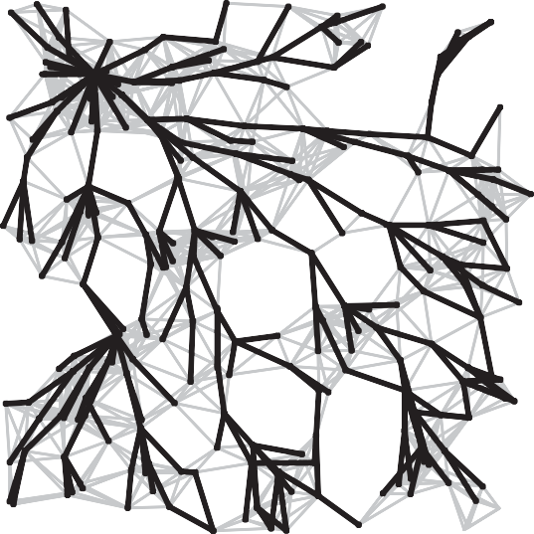
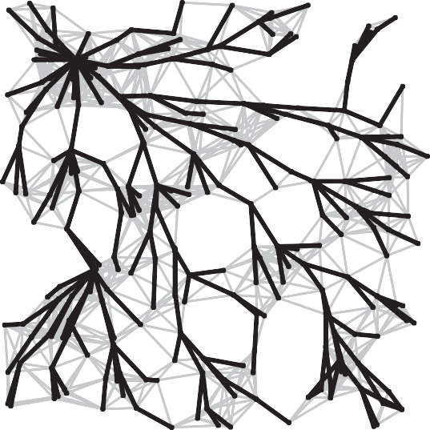
Bellman-Ford Algorithm Visualization
passes 4
7
10
13
SPT

Slide 45
Quiz
Given a graph where all edges have positive weights, the shortest paths produced by Dijsktra and Bellman Ford algorithm may be different but path weight would always be same.
ANS: True
Dijkstra and Bellman-Ford both work fine for a graph with all positive weights, but they are different algorithms and may pick different edges for shortest paths.

Slide 46
Quiz
Let G be a directed graph whose vertex set is the set of numbers from 1 to 100. There is an edge from a vertex i to a vertex j if either j = i + 1 or j = 3i. The minimum number of edges in a path in G from vertex 1 to vertex 100 is
A. 4 B. 7 C. 23 D. 99
ANS: 7
The task is to find minimum number of edges in a path in G from vertex 1 to vertex 100 such that we can move to either i+1 or 3i from a vertex i.
Since the task is to minimize number of edges, we would prefer to follow 3*i. Let us follow multiple of 3. 1 => 3 => 9 => 27 => 81, now we can't follow multiple of 3 anymore. So we will have to follow i+1. This solution gives a long path.
What if we begin from end, and we reduce by 1 if the value is not multiple of 3, else we divide by 3. 100 => 99 => 33 => 11 => 10 => 9 => 3 => 1
So we need total 7 edges.

